Slide 1
Advance Internship@Clevered
AI Charity Prediction Tool.
App User Manual
Author: Arya Gada

Slide 2
Table of Contents
• Acknowledgement
• About Me
• About my internship with Clevered
• About the App
• How to Use the App
• Limitations and Considerations
• Contact

Slide 3
Acknowledgements
A small vote of thanks for all who have helped you in this journey of App Development – my parents, Mr Ken, Clevered, Mentors, Group Members, Friends, Sites etc and especially my mentor- Mani ma’am for helping me learn and expanding my knowledge in the domains of Machine Learning and AI.

Slide 4
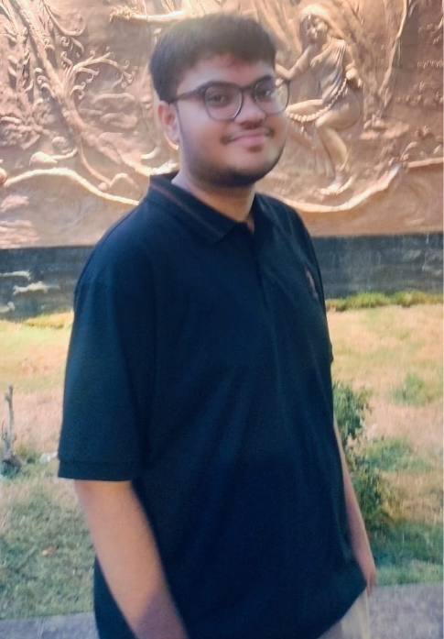
About Me..
Hii, I am Arya Gada, a Grade XII student from Mumbai at Vibgyor, with a strong interest in the intersection of Economics and Computer Science, researching on public policy and commercial applications of Machine Learning.
I aspire to study Economics and Computer Science in the future and hope to do rigorous research.
This internship gave me the opportunity to take those interests a step further by working with real datasets and building a machine-learning solution to a practical problem.

Slide 5
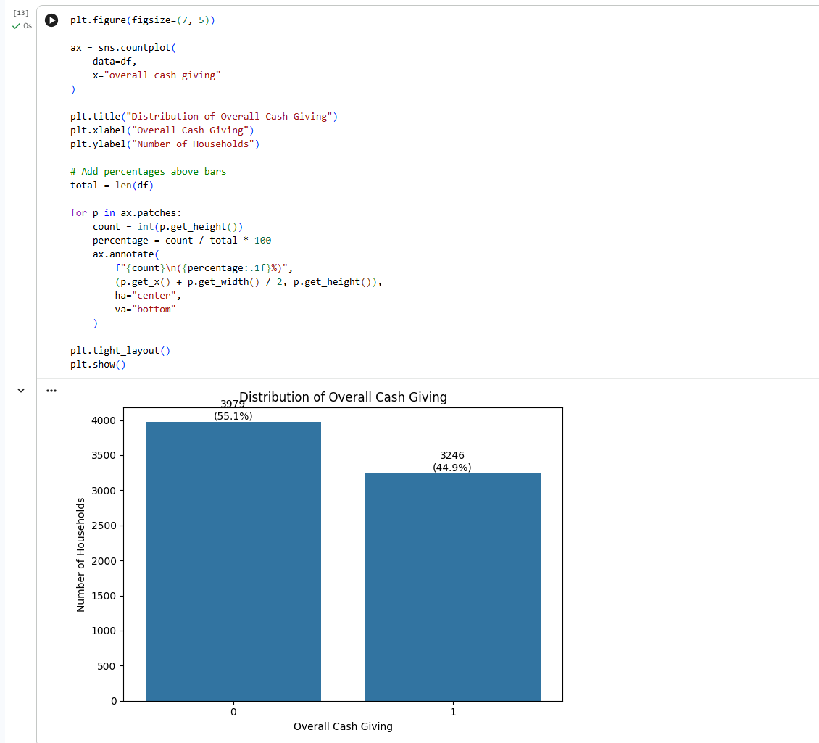
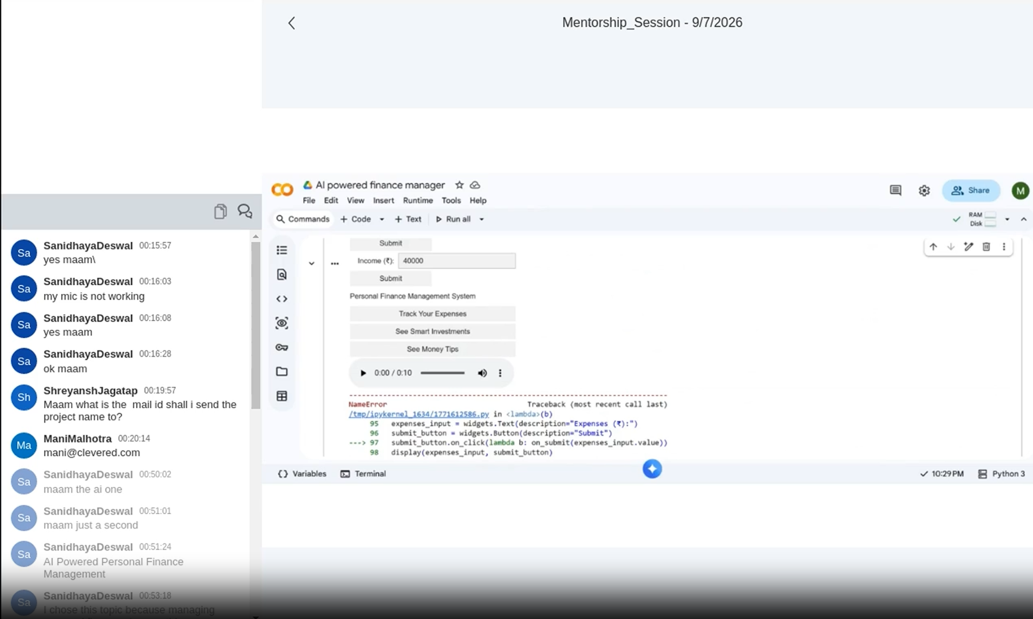
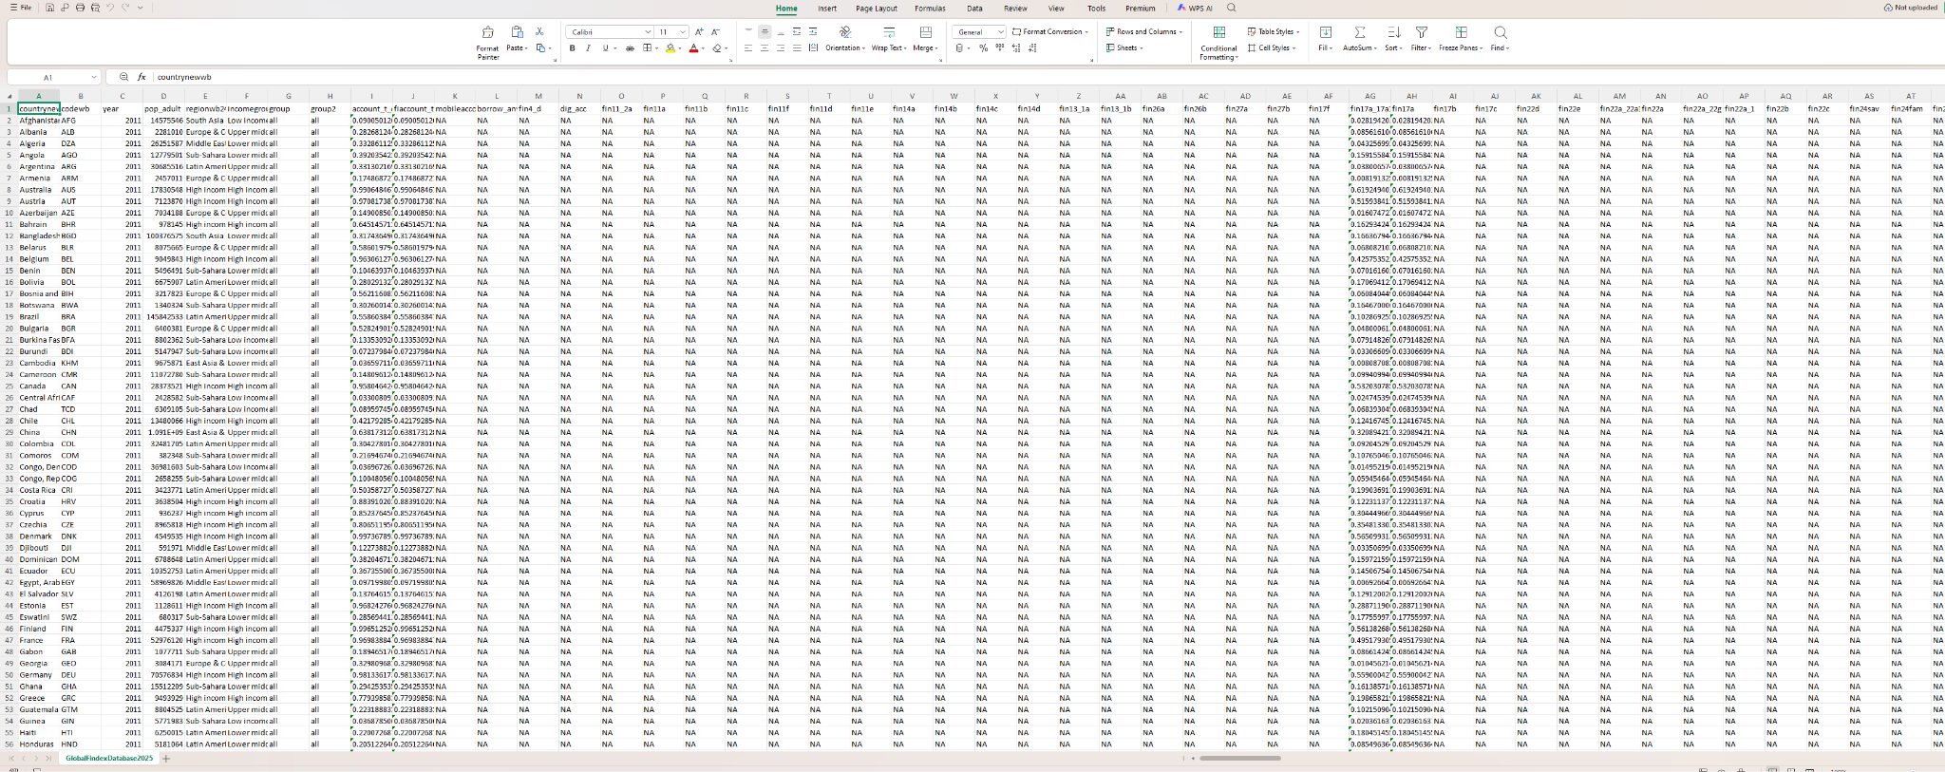
About My Internship with Clevered..
During my internship with Clevered, I worked on an AI-based project focused on predicting household cash-giving behaviour.
What I worked on
• Data collection and preparation
• Exploratory data analysis
• Feature selection and feature engineering
• Machine learning model development
• Logistic Regression and Random Forest modelling
• Model evaluation using accuracy, precision, recall, F1-score and ROC-AUC
• Integration of socioeconomic information from PLFS and Global Findex
• Development of a working prediction prototype
Skills Developed
Python • Pandas • NumPy • Matplotlib • Scikit-learn • Data Analysis • Machine Learning

Slide 6
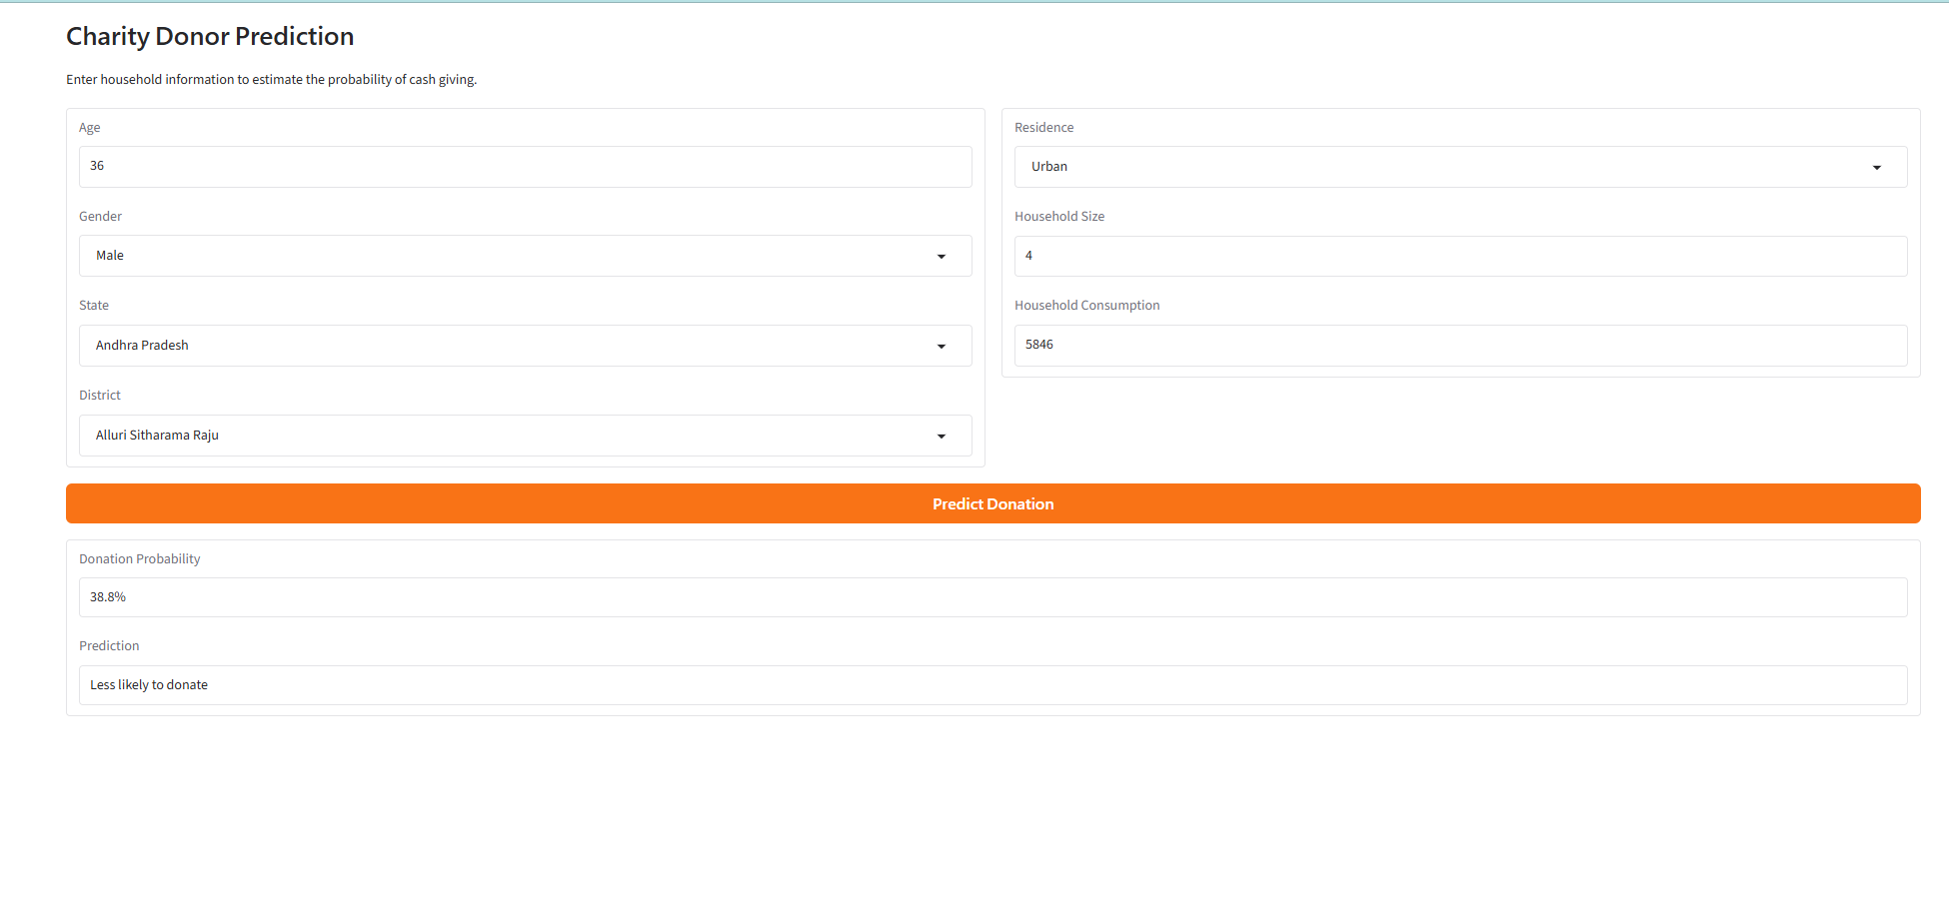
About App..
The Charity Donor Prediction App is a machine-learning prototype designed to estimate the likelihood of a household belonging to the cash-giving donor group. Users enter basic demographic, household, and economic information, and the trained Random Forest model generates a predicted donation probability. The project combines household-level giving data with socioeconomic context from PLFS and financial-inclusion insights from Global Findex to explore the factors associated with charitable giving in India.

Slide 7
How do I use the App?

Slide 8
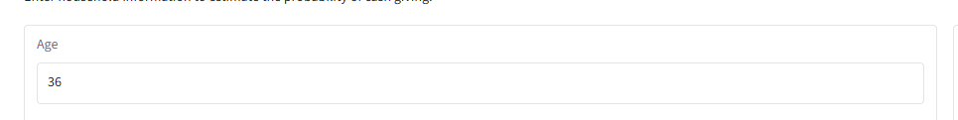
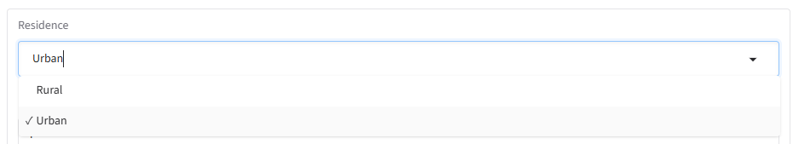
Age and Residence
Enter Age of Donor.
Enter Residence: Urban or Rural.

Slide 9
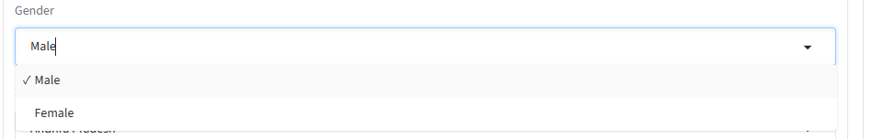

Gender and Household Size
Enter Gender of Donor
Enter Household Size. Household size is defined as people who live in the house permanently, and not tentatively. Guests are not included.

Slide 10
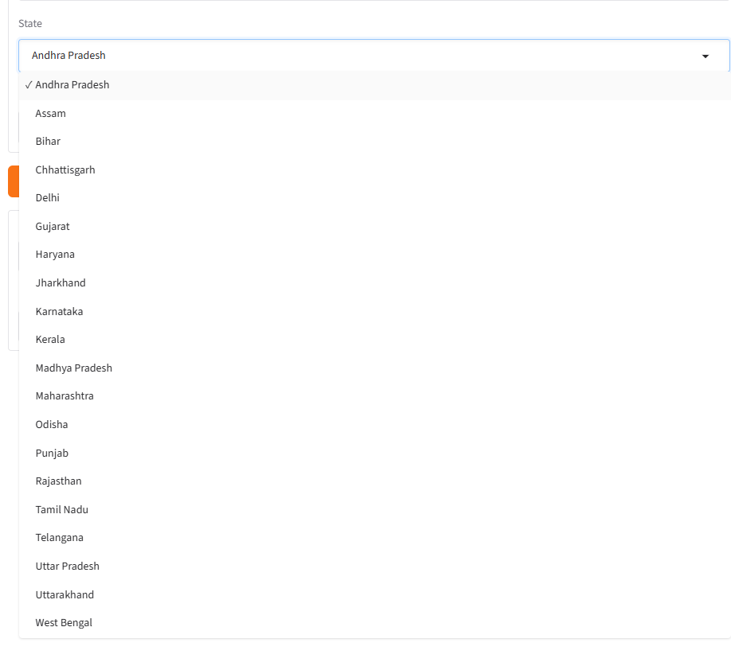
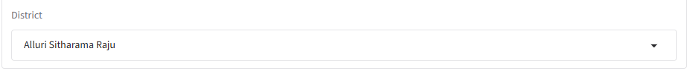
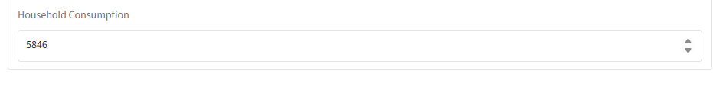
State, District, Consumption
Select from the 28 States in the dropdown menu.
Enter Specific District in the State.
Enter Household Consumption Monthly basis. Money earned through economic activity (not gifts or assets or interest)

Slide 11
Limitations and Considerations
Limitations & Caution
Moderate accuracy: The model achieves around 70% accuracy and a ROC-AUC of 0.71, so predictions are not perfectly reliable.
Prediction ≠ certainty: The output is a probability estimate, not a guarantee that a household will donate.
Data limitations: Model performance depends on the quality, coverage, and representativeness of the underlying datasets.
Hidden assumptions: Some model inputs are estimated or derived from available socioeconomic data when direct household information is unavailable.
Prototype stage: The app is a working ML prototype, not a production-grade donor targeting system.
Responsible use: Predictions should support decision-making, not be used as the sole basis for targeting or excluding individuals or households.

Slide 12
Contact Person
Please reach out to Arya Gada at aryagada00@gmail.com for any questions/ concerns/ suggestions on the App

Slide 13
Thank you!

